Slide 1
Batch Effect Correction Method Evaluation
Yifan Yin

Slide 2
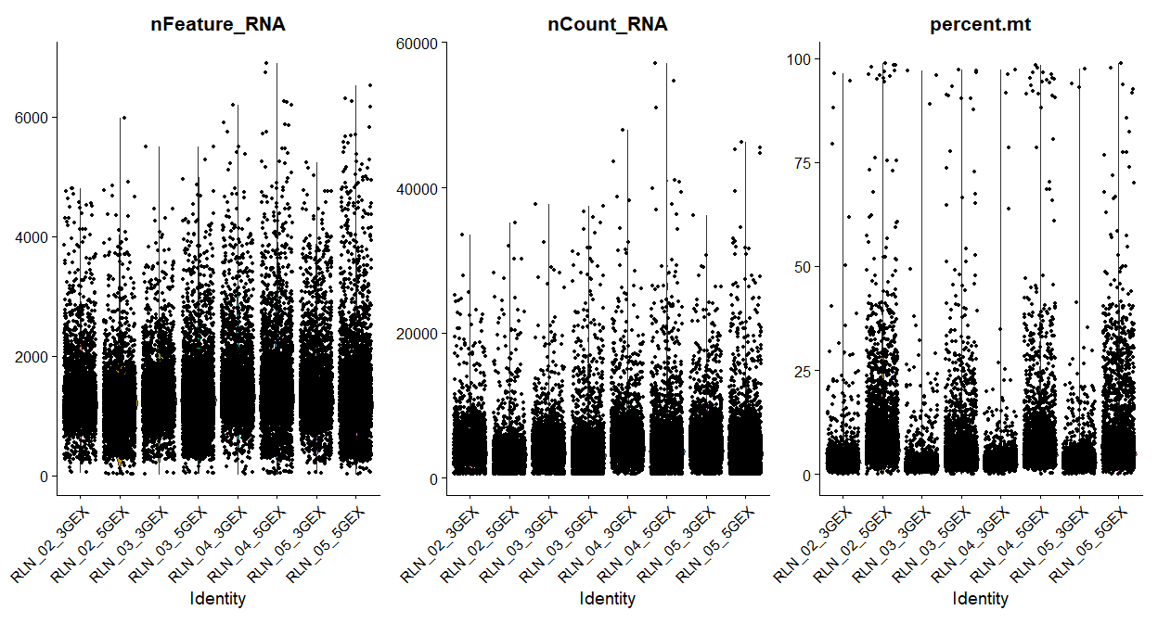
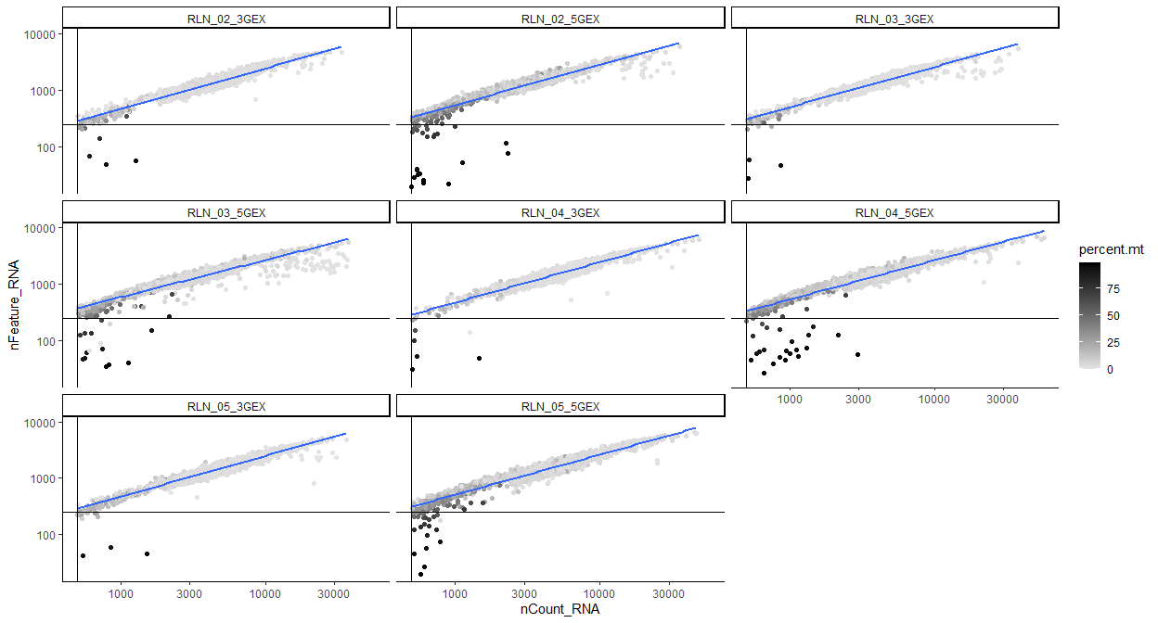
Quality Control
Threshold to keep the cells:
1. Mitochondrial genes < 10%
2. 300< number of genes < 3000
3. Number of counts < 15000

Slide 3
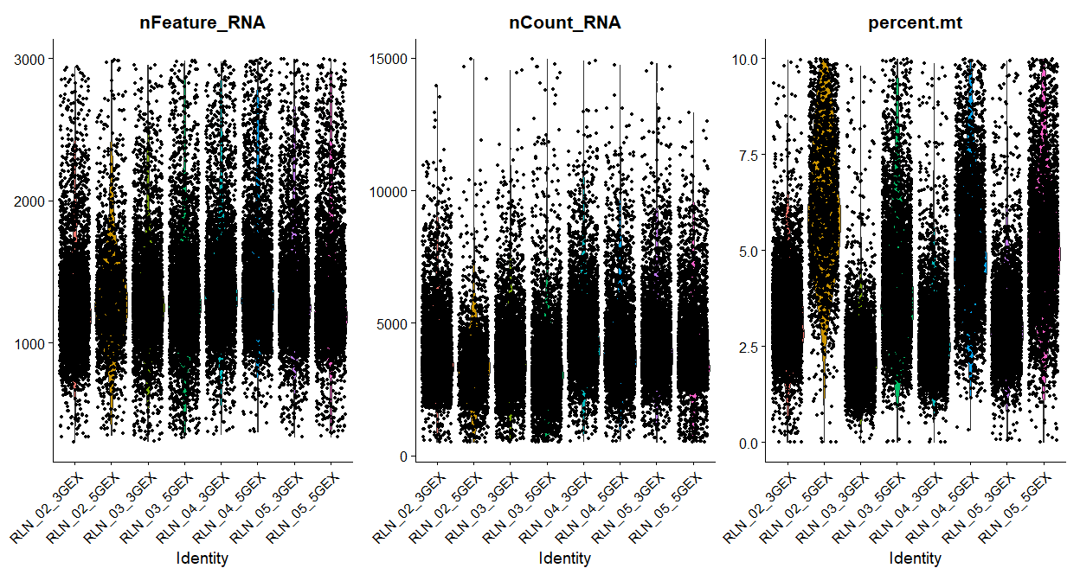
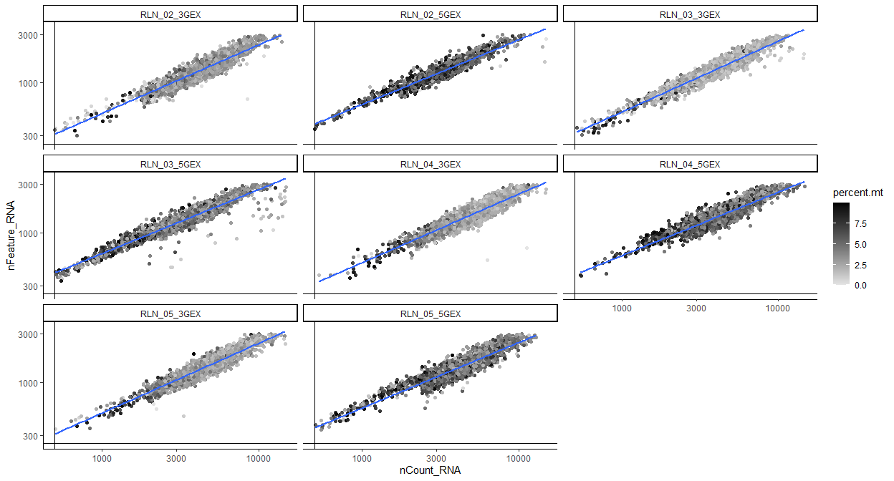
Quality Control
Before: 31358 cells
After: 27719 cells (88% are kept)

Slide 4
Batch Effect Correction
Workflow:
Harmony
Merged 3’ and 5’ dataset Normalization and Scaling PCA RunHarmony() Clustering (dims = 40, resolution = 1.5)
FastMNN
Merged 3’ and 5’ dataset Normalization RunFastMNN() Clustering(dims = 40, resolution = 1.5)
Seurat
Individual dataset Normalization FindIntegrationAnchors() IntegrateData() Scaling PCA Clustering (dims = 40, resolution = 1.5)
LIGER
Merged 3’ and 5’ dataset Normalization and Scaling RunOptimizeALS() and RunQuantileNorm() Clustering(dims = 40, resolution = 1.5)

Slide 5
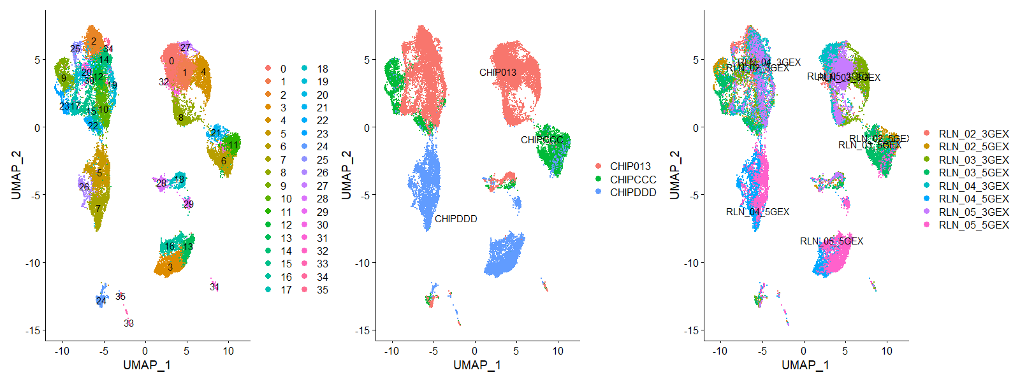
Raw
T cells
B cells
NK cells
Monocyte

Slide 6
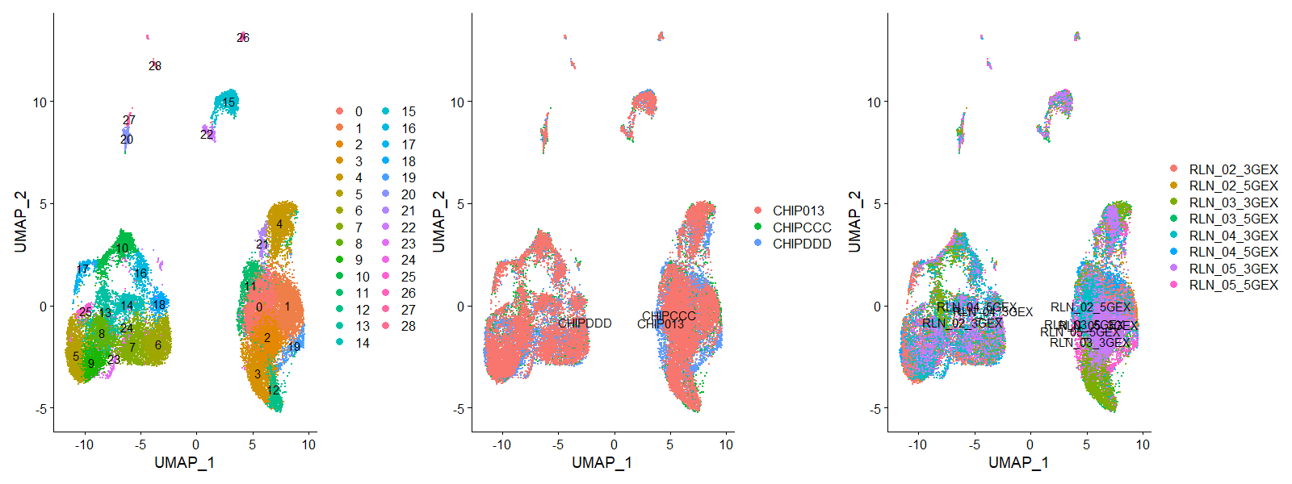
Harmony
NK cells
B cells
T cells

Slide 7
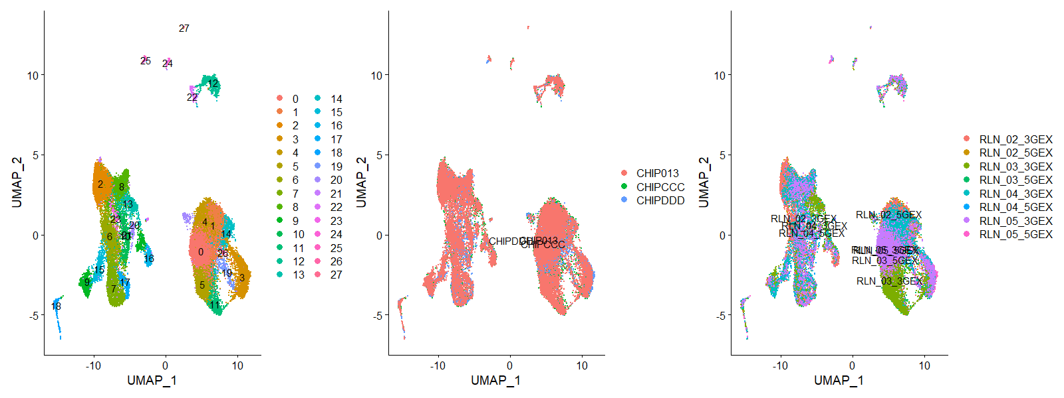
Seurat
Monocyte
T cells
B cells
NK cells

Slide 8
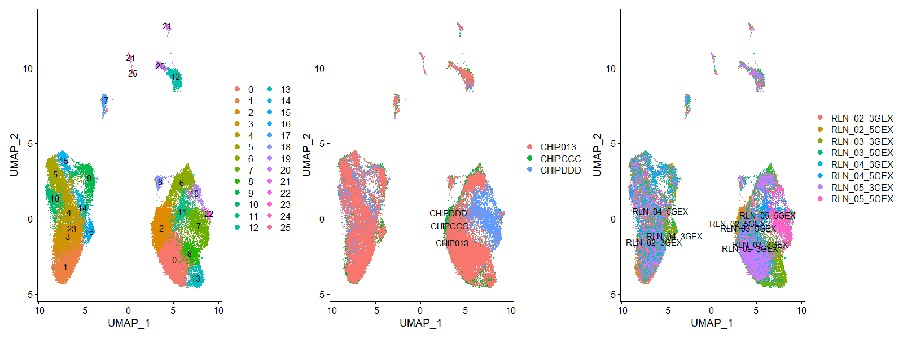
FastMNN
T cells
B cells

Slide 9
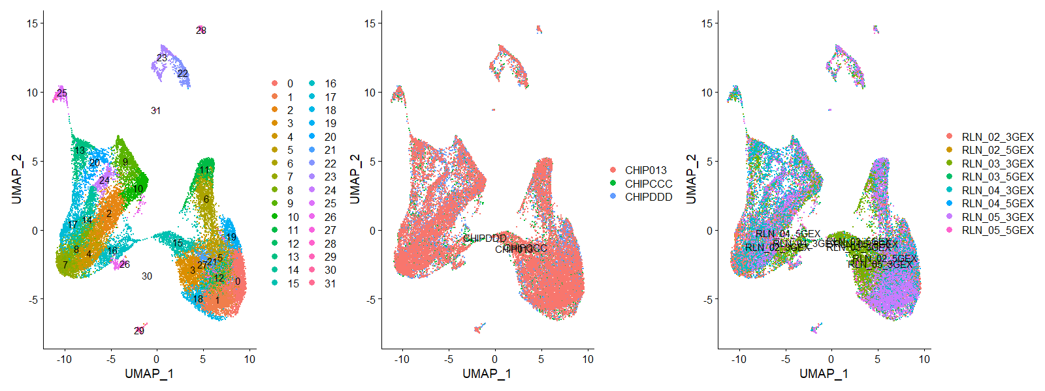
LIGER
NK cells
T cells
B cells

Slide 10
Evaluation
Workflow
kBET
PCs from corrected matrix and Chip as batch labels kBET()
LISI
PCs from corrected matrix and Chip as batch lables compute_lisi()
ASW
Calculate Euclidean distance of the corrected matrix dist() wcSilhouetteObs()
ARI
Calculate kmeans of the corrected matrix adjustedRandIndex()

Slide 11
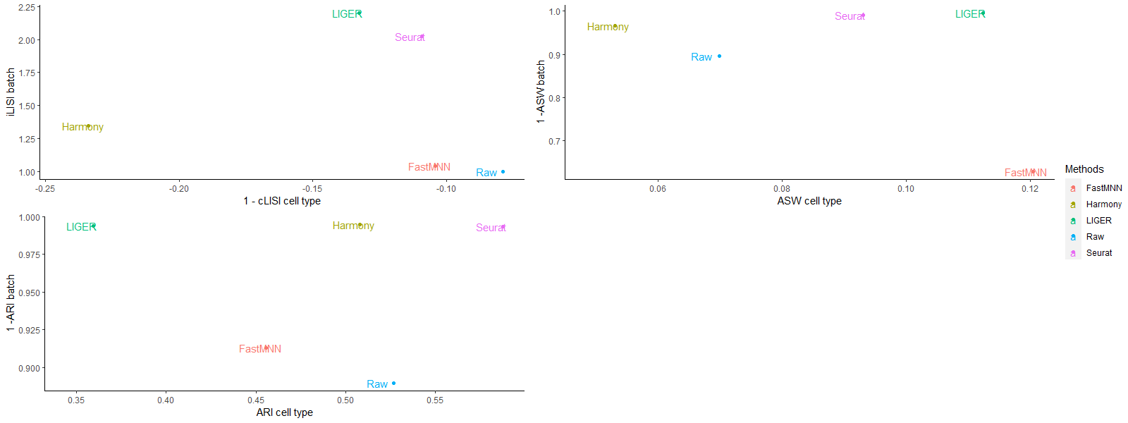
Evaluation Result
X axis stands for the cell type purity
Y axis stands for batch correction
Methods that are on the upper right are the good performing methods

Slide 12
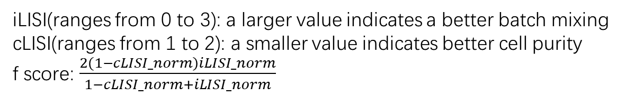
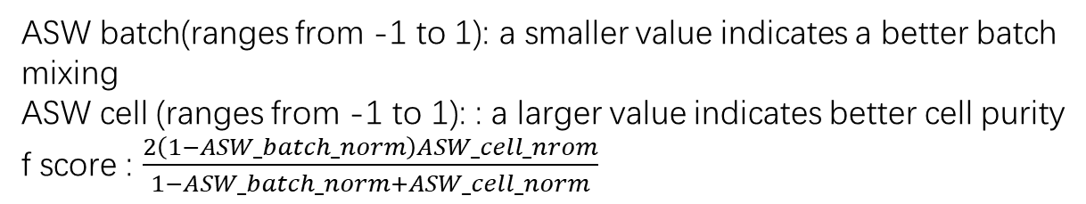
Evaluation Metrics
iLISI(ranges from 0 to 3): a larger value indicates a better batch mixing
cLISI(ranges from 1 to 2): a smaller value indicates better cell purity
f score: $\frac{2\left(1−cLISI_norm\right)iLISI_norm}{1−cLISI_norm+iLISI_norm}$
 | iLISI_median | cLISI_median | iLISI_norm | cLISI_norm | fscore | Rank
Seurat | 2.022807 | 1.109207 | 0.851829 | 0.195329 | 0.827579 | 1
LIGER | 2.200718 | 1.132645 | 1 | 0.346671 | 0.79032 | 2
FastMNN | 1.040737 | 1.104268 | 0.033927 | 0.163435 | 0.06521 | 3
Raw | 1 | 1.078957 | 0 | 0 | 0 | 4
Harmony | 1.345822 | 1.233825 | 0.288013 | 1 | 0 | 4
ASW batch(ranges from -1 to 1): a smaller value indicates a better batch mixing
ASW cell (ranges from -1 to 1): : a larger value indicates better cell purity
f score : $\frac{2\left(1−ASW_batch_norm\right)ASW_cell_nrom}{1−ASW_batch_norm+ASW_cell_norm}$
 | ASW_batch_median | ASW_cell_median | ASW_batch_norm | ASW_cell_norm | fscore | Rank
LIGER | 0.004593 | 0.112431 | 0 | 0.88133 | 0.936922 | 1
Seurat | 0.010218 | 0.093067 | 0.015356 | 0.593744 | 0.740789 | 2
Raw | 0.103728 | 0.069857 | 0.270638 | 0.249027 | 0.371286 | 3
Harmony | 0.034348 | 0.05309 | 0.081232 | 0 | 0 | 4
FastMNN | 0.370895 | 0.120421 | 1 | 1 | 0 | 4

Slide 13
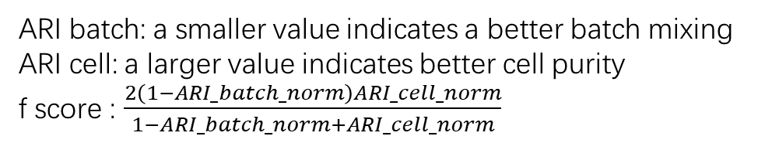
Evaluation Metrics
ARI batch: a smaller value indicates a better batch mixing
ARI cell: a larger value indicates better cell purity
f score : $\frac{2\left(1−ARI_batch_norm\right)ARI_cell_norm}{1−ARI_batch_norm+ARI_cell_norm}$
 | ARI_batch_median | ARI_cell_median | ARI_batch_norm | ARI_cell_norm | fscore | Rank
Seurat | 0.006353 | 0.587736 | 0.011077 | 1 | 0.994431 | 1
Harmony | 0.00519 | 0.507882 | 0 | 0.650025 | 0.787897 | 2
FastMNN | 0.086949 | 0.45566 | 0.778234 | 0.421155 | 0.290542 | 3
Raw | 0.110247 | 0.526794 | 1 | 0.73291 | 0 | 4
LIGER | 0.006218 | 0.359565 | 0.009785 | 0 | 0 | 4
kBET (ranges from 0 to 1) :a smaller value indicates a better batch mixing
kBET
Sample size | 5% | 10% | 15% | 20% | 25%
FastMNN | 1 | 1 | 1 | 1 | 1
Harmony | 1 | 1 | 1 | 1 | 1
Seurat | 1 | 1 | 1 | 1 | 1
Raw | 1 | 1 | 1 | 1 | 1
LIGER | 1 | 1 | 1 | 1 | 1

Slide 14
Evaluation Metrics
Rank sums
 | LISI_rank | ASW_rank | ARI_rank | rank_sum | final_rank
Seurat | 1 | 2 | 1 | 4 | 1
LIGER | 2 | 1 | 4 | 6 | 2
Harmony | 4 | 4 | 2 | 10 | 3
FastMNN | 3 | 4 | 4 | 11 | 4
Raw | 4 | 3 | 4 | 11 | 4
Dataset 5
 | ARI_rank | ASW_rank | LISI_rank | kBET_rank | rank_sum | final_rank
Harmony | 1 | 1 | 4 | 4 | 10 | 1.5
Seurat 3 | 2 | 2 | 3 | 3 | 10 | 1.5
LIGER | 9 | 7 | 1 | 1 | 18 | 3
fastMNN | 3 | 4 | 6 | 6 | 19 | 4
Seurat 2 | 5 | 12 | 2 | 2 | 21 | 5
MMD-ResNet | 10 | 5 | 5 | 5 | 25 | 6.5
MNN Correct | 4 | 3 | 9 | 9 | 25 | 6.5
scMerge | 7 | 11 | 8 | 8 | 34 | 8
ComBat | 6 | 6 | 12 | 11 | 35 | 9
scGen | 12 | 10 | 7 | 7 | 36 | 10
Scanorama | 8 | 8 | 11 | 10 | 37 | 11
ZINB-WaVE | 11 | 13 | 10 | 12 | 46 | 12
limma | 13 | 9 | 13.5 | 13 | 48.5 | 13
Raw | 14 | 14 | 13.5 | 14 | 55.5 | 14
Tran, H.T.N., Ang, K.S., Chevrier, M. et al. A benchmark of batch-effect correction methods for single-cell RNA sequencing data. Genome Biol 21, 12 (2020). https://doi.org/10.1186/s13059-019-1850-9

Slide 15
Acknowledgement
I would like to express my appreciation to Dr. Steidl, Lauren and Stacy for being willing to supervise my rotation study and for providing me with valuable advise on my project.

